Slide 1
Chapter 10 (Part 3): Behavior in Social & Cultural Context

Slide 2
“Us vs. Them”
Think of any major conflict going on in the world
How many are related to some type of group identity, group need, or group goal?
Evolutionarily, personal survival has depended on group survival
Keeping resources within a group while denying resources to outgroup members may have provided a selective advantage

Slide 3

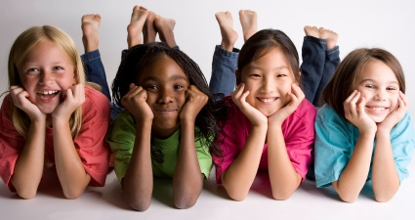
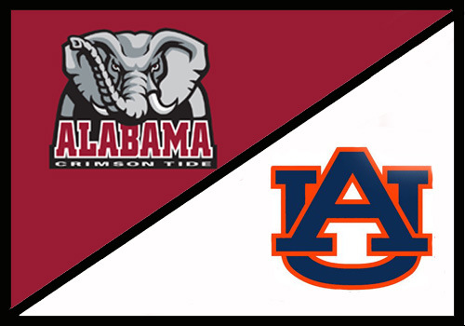
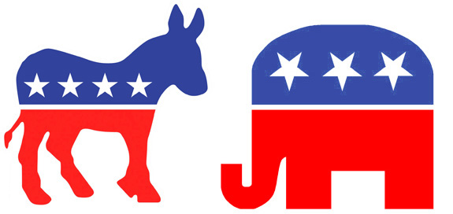

Types of groups
Groups to which we belong are ingroups; those to which we do not belong are outgroups

Slide 4
Social identity: the part of a person’s self concept that is based on his or her identification with a nation, religious group, political group, occupation, or other social affiliation
Ethnic identity
YOU
Political identity
Religious identity
Collegiate affiliation
Gender identity

Slide 5
“Us vs. Them”
People have strong emotional connections to these different identities
The more central a given identity is to a person’s sense of self, the greater emotional investment
Ethnocentrism
The belief that one’s own ethnic group, nation, or religion is superior to all others
Universal phenomenon
This belief increases commitment to group identity, influences behaviors

Slide 6
Stereotypes
Summary impression of a group, in which a person believes that all members of the group share a common trait or traits
Allow for easy, fast processing of social information
Occur automatically, largely outside of our awareness
Affect impression formation
Universal phenomenon
Nationality: American, British, French, Italian, etc.
Ethnic group: White, Black, Hispanic, Asian American, etc.
Age: teens vs. old people, “millenials”, “baby boomers”
Ideological: liberal vs. conservative, religious vs. atheistic
Role-specific stereotypes: “soccer mom”, professor
Notes:
Students may wonder about the processes underpinning the learning of stereotypes.

Slide 7
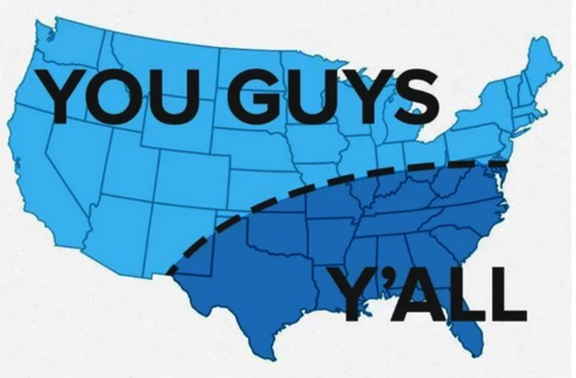
Can be positive, negative, or neutral
Positive: welcoming, kind, polite
Negative: uneducated, overweight, don’t wear shoes
Neutral: conservative, like country music, “y’all”

Slide 8
Can stereotypes Be dangerous?
(Yes, obviously)

Slide 9
“I think old people are slow-moving, boring, and have difficulty understanding new things.”
Stereotype

Slide 10
“I don’t like old people because I think they are slow-moving, boring, and have difficulty understanding new things.”
Prejudice
Negative feelings, opinions, and beliefs associated with a stereotype

Slide 11
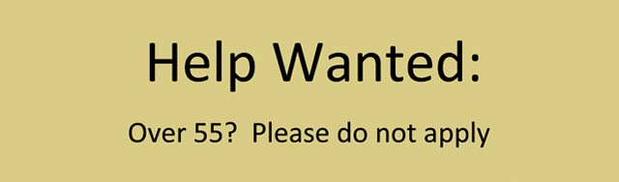
“I’m not going to hire this old person because I think old people are slow-moving, boring, and have difficulty understanding new things.”
Discrimination
Inappropriate and unjustified treatment of people as a result of prejudice

Slide 12
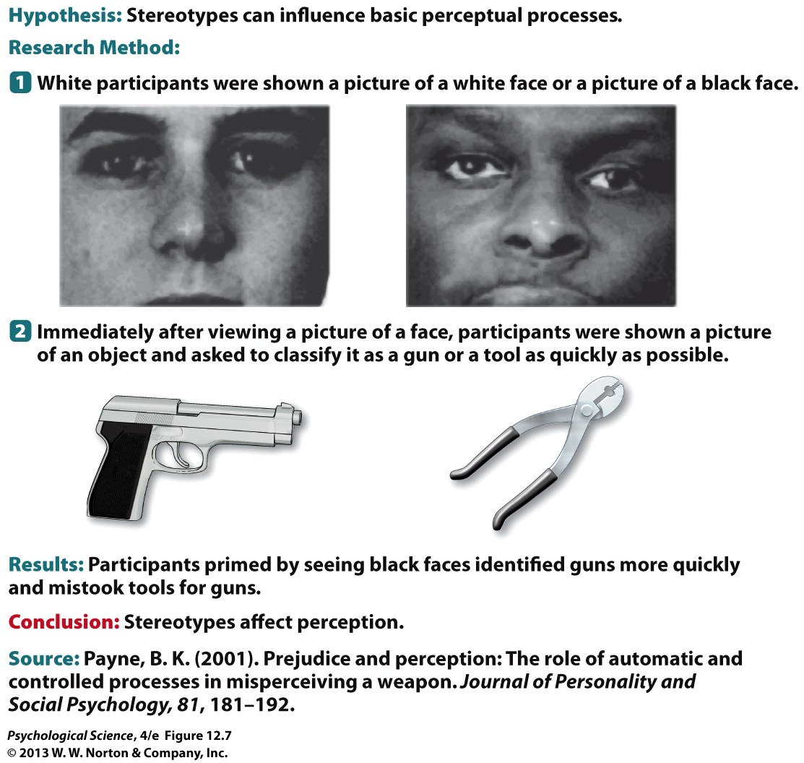
Stereotypes & Perception
Stereotypes can influence basic perceptual processes:
Notes:
Students may wonder about how stereotyping and its associated concepts relate to the development of racism.

Slide 13
Why do stereotypes lead to prejudice and discrimination?
Psychological reasons
Improves self-esteem to see other groups as inferior
Transfer frustrations of life onto other groups

Slide 14
Why do stereotypes lead to prejudice and discrimination?
Psychological reasons
Social reasons
Conformity (friends, family, work associates)
Developmental influence (“My parents always said…”)
Tradition (“We have never associated with [insert group]...”)

Slide 15

Why do stereotypes lead to prejudice and discrimination?
Psychological reasons
Social reasons
Economic causes
“They took our jobs”
Competition creates distrust, anger

Slide 16
Why do stereotypes lead to prejudice and discrimination?
Psychological reasons
Social reasons
Economic causes
Cultural or national causes
Regional conflicts, war
Enemies are described as “dogs”, “vermin”, “scum”, “heathens”, “rats”, etc.

Slide 17
How are stereotypes maintained?
Stereotypes exaggerate differences between groups
“Otherness” is enhanced
Stereotypes underestimate differences within the stereotyped group
Outgroup homogeneity effect: Once we categorize others as ingroup or outgroup members, we tend to view outgroup members as less varied than ingroup members
Stereotypes are self-maintaining
They direct our attention toward information that confirms them and away from disconfirming evidence
Subtyping: When we encounter someone who does not fit a stereotype, we put that person in a special category rather than alter the stereotype

Slide 18
Liberal
Conservative

Slide 19
“Democrats”
“Republicans”
Liberal
Conservative
“Jerome’s not like other Republicans. He’s actually pretty liberal on many issues.”
AVERAGE
Estimated
AVERAGE

Slide 20
Inhibiting Stereotypes
We can consciously alter our automatic stereotyping
Presenting positive examples of admired Black individuals (e.g., Denzel Washington) produced more-favorable responses toward African Americans
Training people to respond counter-stereotypically — having them press a “no” key when they saw an elderly person paired with a stereotype of the elderly — led to reduced automatic stereotyping
Telling people that their test scores indicate that they hold negative stereotypes can motivate people to correct their beliefs, and the worse they feel about holding those beliefs, the harder they try not to be biased
However, in everyday life, inhibiting stereotyped thinking is difficult and requires self-control
Notes:
Students may think that they are less likely than others to fall prey to automatic activation of stereotypes.

Slide 21
What reduces conflict and prejudice?
Equal legal status, economic opportunities, and power among different groups
Authorities and community institutions provide moral, legal, and economic support for both sides
Both sides must have many opportunities to work and socialize together, formally and informally
Contact hypothesis
Cooperation and working together for a common goal

